Slide 1
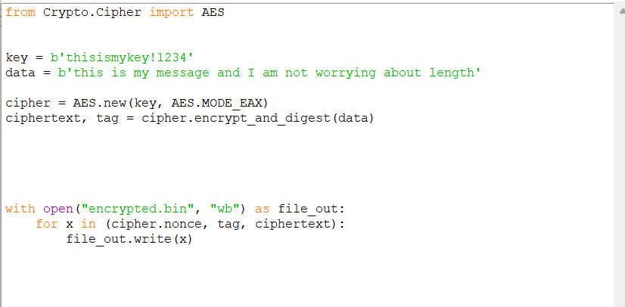
Add import json, base64
Convert to Base64 strings
ciphertext_b64 = base64.b64encode(ciphertext).decode()
Also convert tag and cipher.nonce
Create a dictionary
Dump JSON to a file

